Slide 1


Data
Analysis

Slide 2


Today's agenda
Project recap
Problem
The Analytics team
Process
Insights
Summary

Slide 3

Social Buzz is a technology unicorn that needs to adapt quickly to its global scale.
Accenture has begun a 3 month POC focusing on these tasks:
- An audit of their big data practice
- Recommendations for a successful IPO
- An analysis to find the top 5 most popular categories of content
Project Recap

Slide 4

Problem
Over 100000 posts per day
36,500,000 pieces of content
Per year
But how do we capitalize on it when there is so much?
Analysis to find Social Buzz’s top 5 most popular categories of content

Slide 5



Andrew Fleming
Chief Technical Architect
The Analytics team
Marcus Rompton
Senior Principle
Dnyaneeshwar
Koradiya
Data Analyst

Slide 6
Process
1
Data Understanding
2
Data Cleaning
3
Data Modelling
4
Data Analysis
5
Uncover Insights

Slide 7

Insights
16
January
1897
Unique Categories
Month we highest posts
Reactions on ‘Animals’ posts

Slide 8
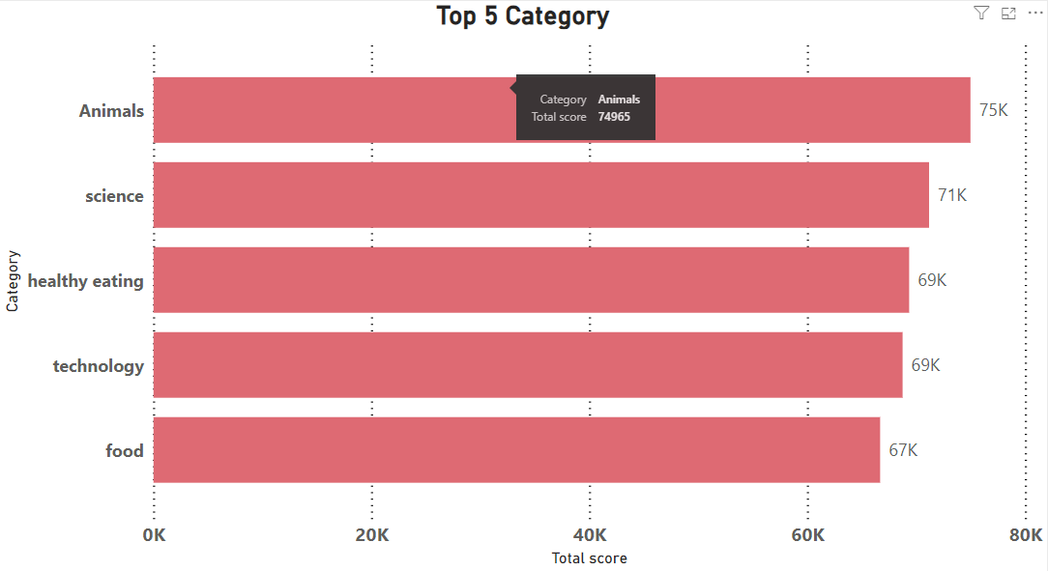

Slide 9
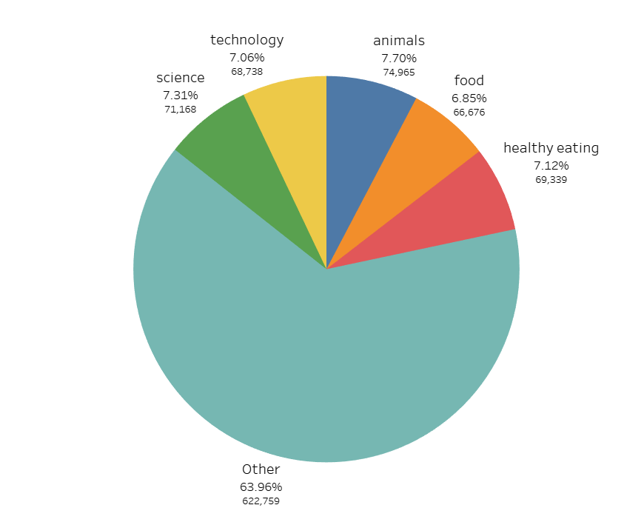

Slide 10

Analysis
Animals and science are the top 2 categories indicating that people like real life and factual content most.
Insight
As food is a common topic/category in the top 5 and healthy eating comes under it, the company can increase engagement by campaigning and working with healthy eating brands.
Similarly, technology is a branch of science and can increase engagement by collaborating with tech brands and tech influencers.
Summary

Slide 11
Thank you!
ANY QUESTIONS?

